Slide 1

Welcome to the Year 3 Parent Information.
Holly
Miss McClelland
Miss White
Mrs Hawkins
Year 3 Staff
Maple
Mrs Sheptuha
Mrs Richardson
Mr Pickard
September 2026 – July 2027

Slide 2
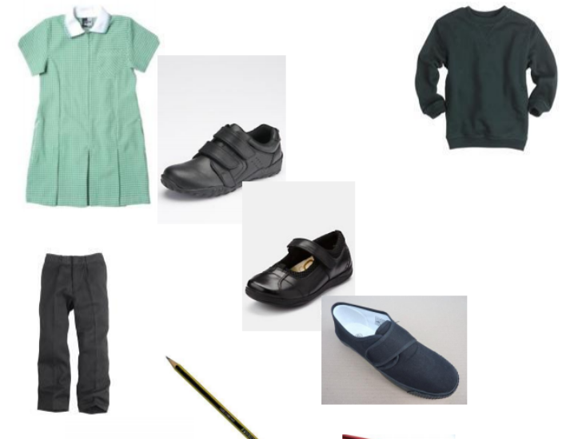
School Uniform and Equipment Policy
School Uniform
All children must wear school uniform.
Trainers are recommended for P.E. outside.
Ensure all uniform is clearly labelled.
Jewellery
Jewellery is not to be worn.
Exceptions – a watch and small stud earrings (which must be removed before PE, by you). Remove them at home before school please.
Equipment
Stationery – Everything needed will be provided by the school.

Slide 3

OPAL
Please note that the children are now expected to play outside in all weathers. Therefore, it is important to make sure that they have a raincoat, wellies and a change of socks at school.

Slide 4


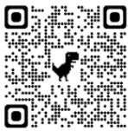
myHappymind is an NHS-backed curriculum in primary schools, secondary schools, and nurseries and is focused on building resilience, self-esteem, and happiness in children.
26/27 - Getting Started - myHappymind Learning Portal
115309

Slide 5
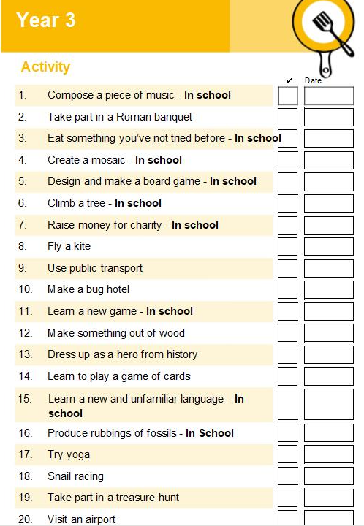
School Enrichment Booklet
This year, our Enrichment Booklet will give children exciting opportunities to extend their learning through a range of fun and creative activities. Some tasks will be completed in school, while others can be enjoyed at home with family support. The activities are designed to encourage independence, curiosity and a love of learning, while allowing children to explore their interests and celebrate their achievements. We look forward to seeing the wonderful work the children produce throughout the year.

Slide 6
TIMETABLE
Your child’s weekly timetable is available on the class page on the Thomas Willingale website.
PE: Mondays and Wednesdays.
Your children should come into school on their P.E. day in their full PE kit as well as a tracksuit (black, green, grey). Trainers are preferable as the children will be outside where possible.
As children are not allowed to wear earrings for PE it is advisable that the children take them out before coming to school. This will prevent them from getting lost or broken.

Slide 7
Bags - The school book bag is sufficient for every child’s day to day needs.
Money – Remember we are now a cash free school, the only money which should be brought into school by your children should be for tuck shop (when it reopens) or fund-raising events. Even then, do not send your children in with large amounts of money/notes.
Educational visits – We expect to take the children on one trip over the course of the year. Although we only ask for voluntary contributions towards the cost of any educational visit, it is important that we do raise the funds to cover the cost of the trip otherwise it may be cancelled. Unfortunately, the school can no longer afford to subsidise trips.

Slide 8
THE CURRICULUM IN YEARS 3
MATHEMATICS – these are some of the main Targets
YEAR 3
To recall multiplication and division facts for the 3, 4 and 8 times tables.
To compare and order numbers to 1000.
To recognise the place value of each digit in a 3 digit number.
To count up and down in tenths.
To compare different units of measure.
To tell the time using an analogue clock for both 12 and 24 hour times.
The children work towards these targets during their maths lessons.

Slide 9
WRITING : main targets
Year 3
To spell the commonly misspelt words from the year 3/ 4 list.
To write with spaces between words, use the correct size letters and orientation and begin to use strokes that will support joining,
To can write a narrative with a clear structure, setting, characters and plot.
I can proof-read to check for errors in spelling and punctuation.
To start to use paragraphs.
To use capital letters, full stops, and exclamation marks, commas for lists, question marks mostly correctly.
The children work towards these targets during their English lessons.

Slide 10
READING – these are some of the main targets
Year 3
To read a range of fiction, poetry, plays, and non-fiction texts with confidence and fluency.
To identify the main point of a text.
To predict what might happen based on the details read.
To maintain a positive attitude towards reading
The children work towards these targets during shared reading as well as through their daily lessons.

Slide 11
TOPICS AND THEMES
We follow a creative curriculum which enables the children to be taught about different subject areas in a fun and engaging way.
This term we will be looking at Trade and Transport. We will look at changes in transport and trade over history. In Spring 1, we will focus on DT through our topic Makey Makey. Additionally, in Spring 2, our topic will be It’s Good to Talk. Finally, in Summer, our topic will be Land of Hope of Glory.
Where possible our scientific learning will also be taught under the thematic umbrella, but due to the nature of our topics this may not always be possible. The science areas of study for Year 3 are…
Animals including humans
Light and dark
Forces
Plants
Rocks and soils

Slide 12
Rewards
House Points
Each child is allocated a house.
They can earn points for their houses.
Some ways the children can earn them…
being polite, good behaviour, answering questions, manners etc.
Each week the house which has received the most points wins a trophy and at the end of each term the winning house has extra play time.
Merits
Bronze merit card progress to silver, gold then platinum.
Merit cards are stamped and children have the opportunity to visit various members of senior staff to share their success.
Examples of how merits can be earned include : - producing excellent work, answering questions, doing an activity for which your child has tried their hardest, and for homework.

Slide 13
Homework
Each week on Thursday your child will be set homework in a folder- one piece of English and one piece of Mathematics, linked to what we have covered in class. This will need to be returned by the following Tuesday.
Spellings and Times tables
Every Friday, your child will be set spellings to learn. Spellings will be tested the following Friday through dictation.
In addition to this, we will also regularly test your child’s times table knowledge.

Slide 14
Reading Books
Your child will be given a reading book which they will read at school and home.
Please can we ask that you read as many times as possible with your child and put a comment in their reading record.
The children will read regularly in school with an adult, as well as participating in daily shared reading sessions with the class teacher.
Should your child wish to vary their reading material, please encourage them to do so. This can also be noted in their reading diary.

Slide 15
Assessment
Your child’s learning is continually assessed through the year by their class teacher.
Areas of development are constantly assessed and identified - interventions are put into place where necessary.

Slide 16
Statutory Testing
Although there are no formal statutory tests in year 3, we work towards the times table test which is in year 4.
We do however use TTRockstars to practise and test the children’s knowledge. Each child will be given a personal logon for this which will be stuck in the back of their reading diaries.
In year 4:
Children will take an on-screen timed test.
Questions will be pure calculations (no problem solving) but may include missing number e.g. 5 x __ = 35
Children will be tested on questions up to 12 x 12.
As this is a computer based test we must ensure your child’s computing skills don’t hider their ability to complete the test successfully. We recommend that the children practise using the follow website.
https://www.timestables.co.uk/

Slide 17
Communication
Class Pages
As a year group, we shall try to update you with what has been happening during our learning in Year 3 and occasionally suggest activities that you can try at home to further your child’s learning.
Parent Consultation Meetings
The first formal consultation meeting to discuss how your child has settled into year 3 will held on Monday 19th October 2025.
Photography
Please make yourself aware of the photography policy on our website. We will endeavour to put pictures on our class pages to show the children’s learning.
Please advise the office if you DO NOT wish your child's picture to be shared.

Slide 18
ATTENDANCE
Regular attendance is extremely important. Each week the class with the highest attendance is awarded the attendance cup. This encourages the whole class to strive for 100% attendance each week.
Children who achieve 100% attendance over the half term are entered into a draw and over last year prizes have included:
Tickets for Top Golf, Nandos, Pizza Express.

Slide 19

Our Manifesto

Slide 20
Any questions …

