Slide 1

Welcome to our
Year 1 Information Meeting

Slide 2
Year 1 Adults
Oak Class- Mrs Goldie, Mrs Duggan, Miss Posen, Mrs Tappin and Miss Massey
Spruce Class- Miss Hartnell, Mrs Reeve, Mrs Brandon, Miss Stedman and Miss White

Slide 3
Soft Start
You are able to drop off your child at their classroom any time between 8:30am and 8:45am.
Activities are out on the table for the children during this time. The children are expected to put away their lunch boxes, coats, bags and water bottles.

Slide 4
National Curriculum
English reading, writing, phonics | Maths Arithmetic, Reasoning
Science | Computing
PE | RE
History | Geography
PSHE | French
Music | Art and Design Design and Technology

Slide 5

Phonics
*We use a programme called ‘Phonics Bug’ to teach phonics. All children in year 1 will receive twice daily phonics lessons.
*All children in Year 1 will be screened for their phonics in June.
*This screen is a statutory requirement and the results are shared with parents and are sent to the local authority. They will have to decode and read a variety of real and nonsense words. We will have another meeting closer to the test to go over this again.

Slide 6
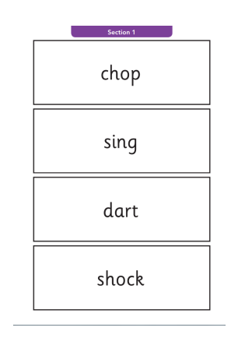
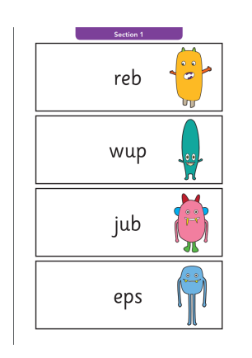
These are examples from a previous test. All nonsense words have an alien picture next to them to show the children they are not real words and should just be sounded out.

Slide 7

Rewards and Sanctions
Traffic light system for behaviour
Merits for outstanding work
House points for good behaviour around the school

Slide 8
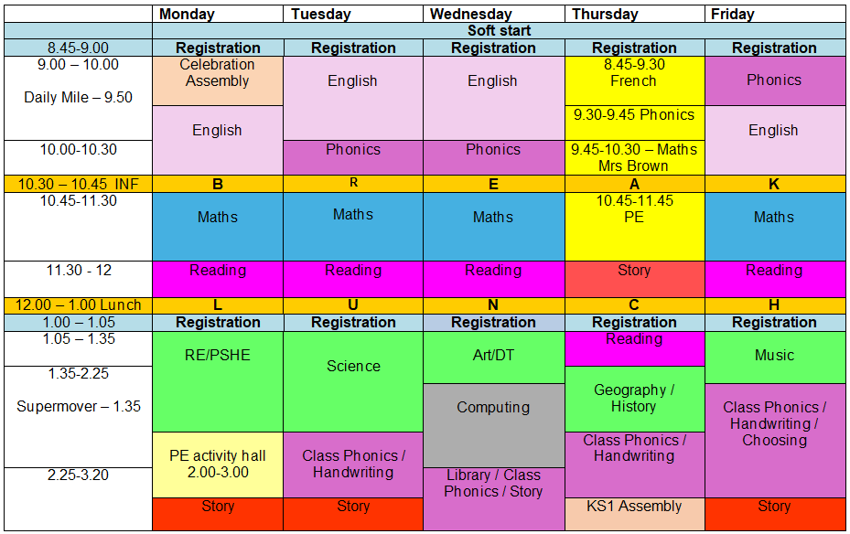
A typical day

Slide 9

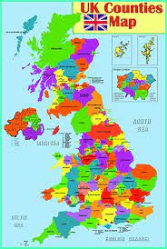


Year One Topics
Autumn 1 and 2 – Weather Watchers!
Spring 1 and 2 – Who’s Your Hero?
Summer 1– Amazing Places and Spaces in the UK
Summer 2 – How to Post a Penguin Egg

Slide 10

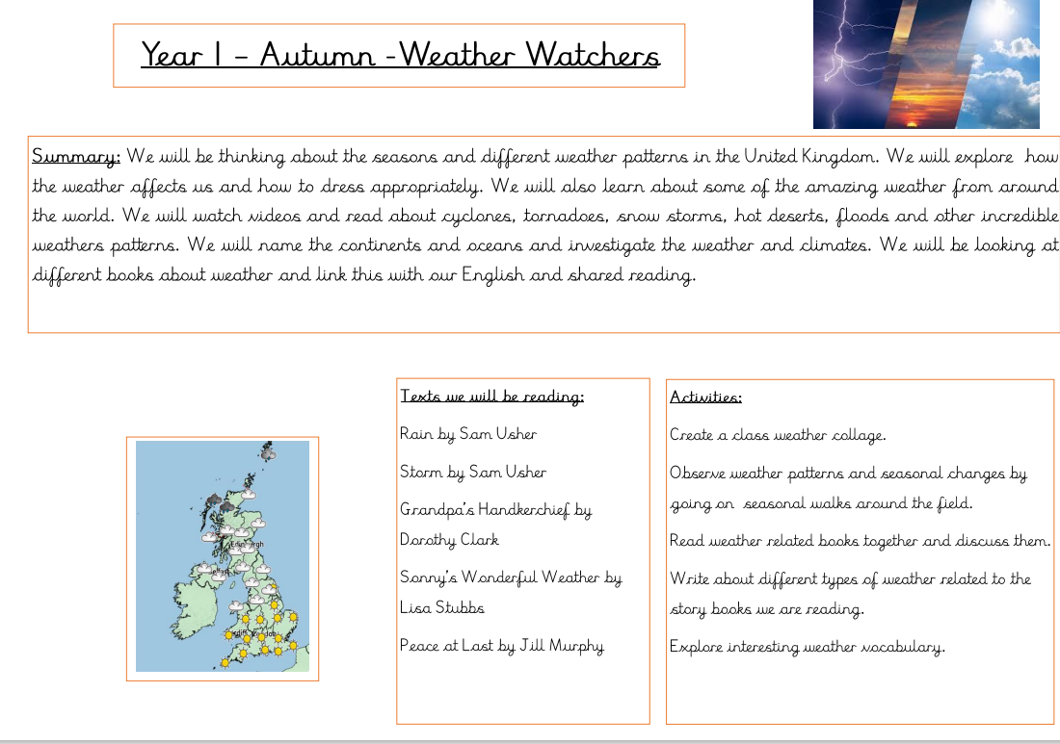
Knowledge Organiser

Slide 11
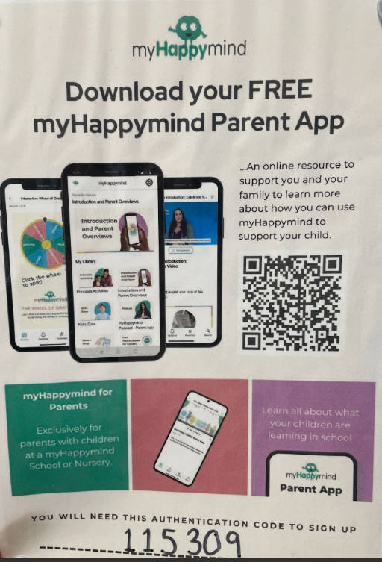
My Happymind

Slide 12

Trips
We are planning two trips this year. We are hoping to visit the Story Centre in Stratford in January and the Epping Forest Field Centre in the summer.

Slide 13
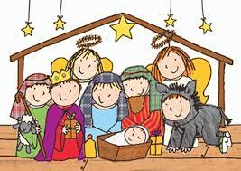
Performance
Year 1 will take part in a Christmas Nativity. You will be invited to come and watch.

Slide 14

Supporting your child at home
Reading
*ALL children should be reading daily at home.
*Please record this in their reading diary.
*Once your child has read their book at least twice, they can ask for it to be changed.
*We aim to change books on Monday and then as requested.
*If your child finishes their school book, please encourage them to read other books/ comics that you may have at home.
*Whilst reading together, please ask your
child questions to check their understanding.

Slide 15
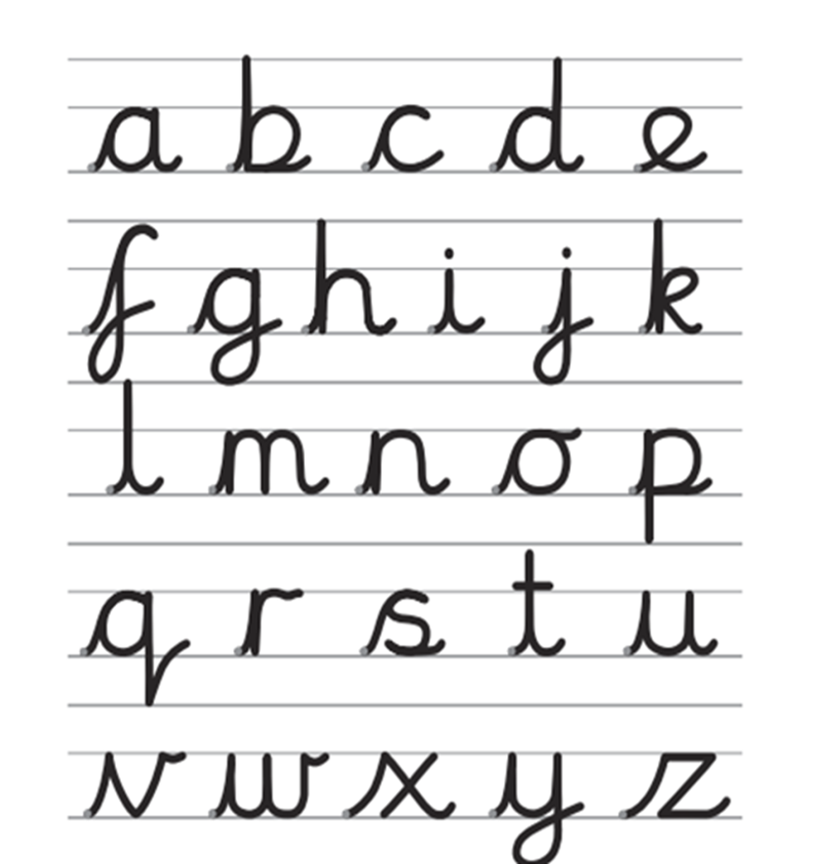

Supporting your child at home
Writing
*All children in Key Stage 1 are encouraged to eventually join their writing using this format:
*The Letterjoin website can be accessed at home using the login information. This can be found in the reading diary.

Slide 16

Supporting your child at home
Maths
*Fluent counting forwards and backwards in ones from any number
*Number bonds – to 10 then to 20
*Number patterns– counting forwards and backwards in 2’s,5’s and 10’s
*Mental addition and subtraction
*Time- Talk about the time, look at o’clock and half past times on a clock.
*Money- recognise coins and notes as they see them.

Slide 17

Supporting your child at home
Homework
*Homework will go out on Thursday to be completed by the following Tuesday.
*Spellings will be given out on a Friday, ready for a test on the following Friday. Please practise at home.
Notes:
Emma

Slide 18

Communication
Messages are sent out on the school app
Check book bag daily
Parent consultations – October and March
Reports – mid year and end of year

Slide 19
What is needed?
Labelled school uniform.
Book bag – reading record returned daily.
PE kit –green, black or grey tracksuit with a yellow T-shirt, trainers.
No earrings on PE days as staff cannot take earrings out.
Children with long hair need their hair tied up.
Forest School alternate Thursdays.
Oak and Spruce both have PE on Monday and Thursday.

Slide 20

OPAL
What is needed?
*Named waterproof trousers and jacket
*Named wellies
*Named spare clothes, including socks

Slide 21

Thank you for listening
Are there any questions?

