Slide 1
Welcome to the Year 6 Information Meeting
Year 6 teachers – Mrs Holland, Miss Dennis
Upper KS2
Phase Leader - Mrs Porter
A copy of this presentation will be available on the TWS website so
you can refer to it at your leisure .

Slide 2
School Uniform and Equipment Policy is
on the website however:
Jewellery
Jewellery is not to be worn.
Nail varnish is not permitted.
Exceptions – a watch and small stud earrings – but not on PE Day.
Equipment /Stationery
Provided by the school.

Slide 3
Mobile Phones
Can be brought to school by your children only if they walk home alone.
They will be collected each morning by class teachers and given out at the end of the school day.
Phones are not to be used on the playground.
Money
The only money which should be brought into school is for tuck shop or fund raising events.

Slide 4
TIMETABLE
Your child’s weekly timetable is available on the Thomas Willingale website.
PE is on Wednesdays and Fridays.

Slide 5
THE YEAR 6 CURRICULUM
MATHEMATICS – we will continue to teach curriculum
objectives for Year 6, addressing any gaps in learning.
YEAR 6
To recall multiplication and division facts to 12 x 12 (Year 4)
To compare and order numbers to at least a 1,000,000.
To recognise the place value of each digit in a 7 digit number.
Long division.
Algebra.
I can use fractions, decimals and percentages.

Slide 6
WRITING
Year 6
To spell the commonly mis-spelt words from the year 3/ 4/5/6 list.
I can produce legible, joined handwriting.
I can use the correct features and sentence structure matched to the text type we are working on.
I can organise my writing into paragraphs to show different information or events.
I can evaluate and edit by ensuring mostly consistent and correct use of tense throughout a piece of writing.
I can use capital letters, full stops, question marks, commas for lists and apostrophes for contraction mostly correctly.

Slide 7
READING
Year 6
I can read age appropriate books with confidence and fluency (including whole novels)
I am familiar with and can talk about a wide range of books and text types, including myths, legends and traditional stories and books from other cultures and traditions. I can discuss the features of each.
I can justify inferences with evidence from the text.
I can retrieve information from a text.

Slide 8
TOPICS AND THEMES
Autumn Term
Subject | Autumn Term
History | Conflict, Crime and Punishment Extending pupils chronological knowledge beyond 1066.
Geography | Mapping – locating counties around the world.
Science | Circulation/Blood/ Heart – how our heart works and how we keep it healthy.

Slide 9
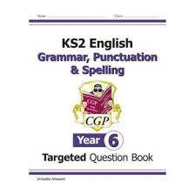

Homework
Your children will be provided with two workbooks for homework which will include Grammar, Punctuation and Spelling, (GPS) and Maths.
Homework will go out every Thursday and needs to be brought back on the following Tuesday. Spellings go out on a Monday to be tested the following Friday.

Slide 10

All site licenses are paid for by the school and your children have individual usernames and passwords which they can use at home as well as in school.

Slide 11
Reading Books –
Your child has chosen a reading book which they will read at school and home.
Please can we ask that you listen to your child read at least once a week, asking them questions about what they have just read and put a signature and a comment in their reading record to let us know how they have got on.
The children can evidence any independent reading themselves, in their Reading Record.
However your child should be reading daily.

Slide 12
Assessment
Assessments throughout the year are a way of teachers finding out exactly what your child’s strengths are, and also the areas which need developing. Any additional support can then be organised so that your child can progress to their maximum potential.
Your child need not worry about these assessments.

Slide 13
SATs
SATs week will begin on the 12th May, 2025. The children will be assessed on:
. Grammar, Punctuation and Spelling (GPS)
. Reading Comprehension
. Maths consisting of three papers – Arithmetic/Reasoning 1 and Reasoning 2.
- Writing is teacher assessed and can be moderated by an external moderator against the national framework.
Throughout the year the children will be assessed as they were in previous years so by the time they get to SATs week they will approach this just as any other assessment.
There will be a specific SATs meeting later in the year to give you any further information you will need.

Slide 14
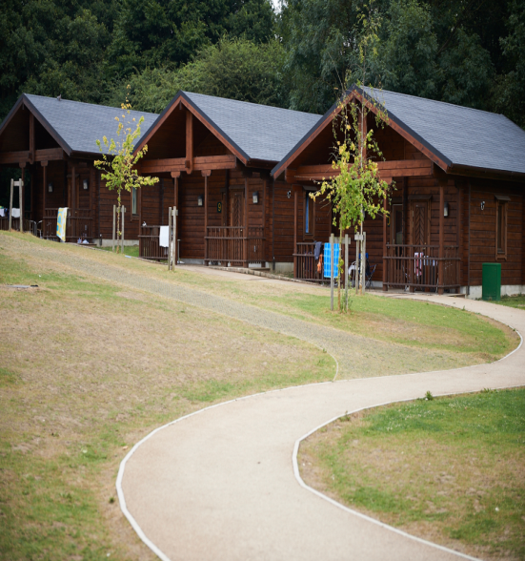
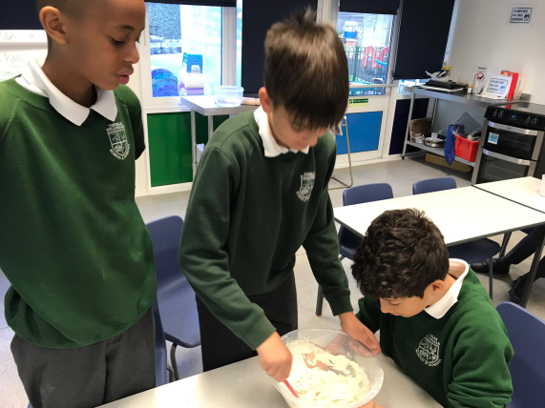
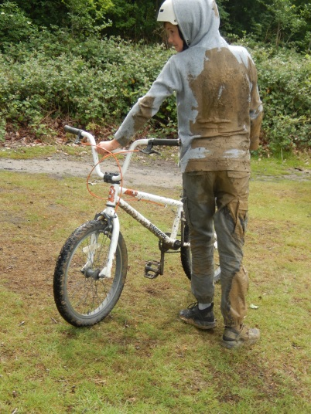
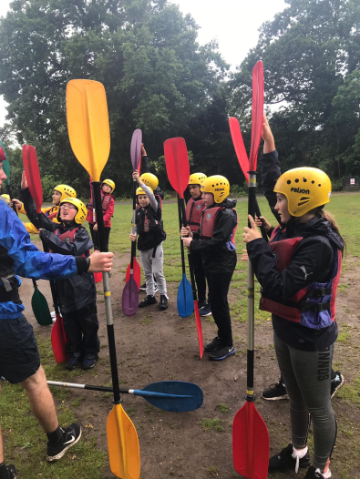
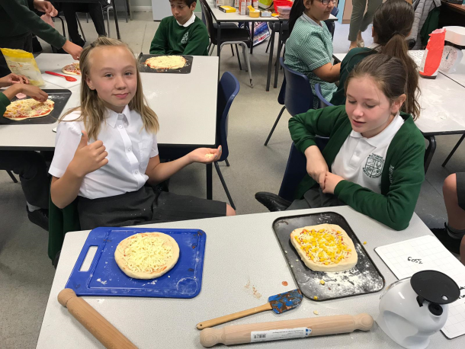
Residential:
Danbury 2025
Wednesday, 11th June – Friday, 13th June
A letter containing details, including a payment plan will be emailed to you.

Slide 15
ATTENDANCE
Regular attendance is extremely important, especially in Year 6, as it affects the whole class. Each week the class with the highest attendance is awarded the attendance cup. This encourages the whole class to strive for 100% attendance each week.
Children who achieve 100% attendance over the half term are entered into a draw and over last year prizes have included :
Tickets for Top Golf, Nandos, Pizza Express, circus, cinema etc.

Slide 16
Any questions?

