Slide 1
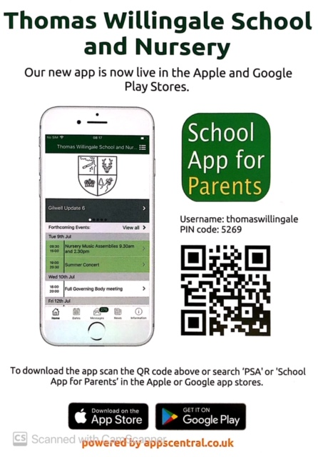

Slide 2
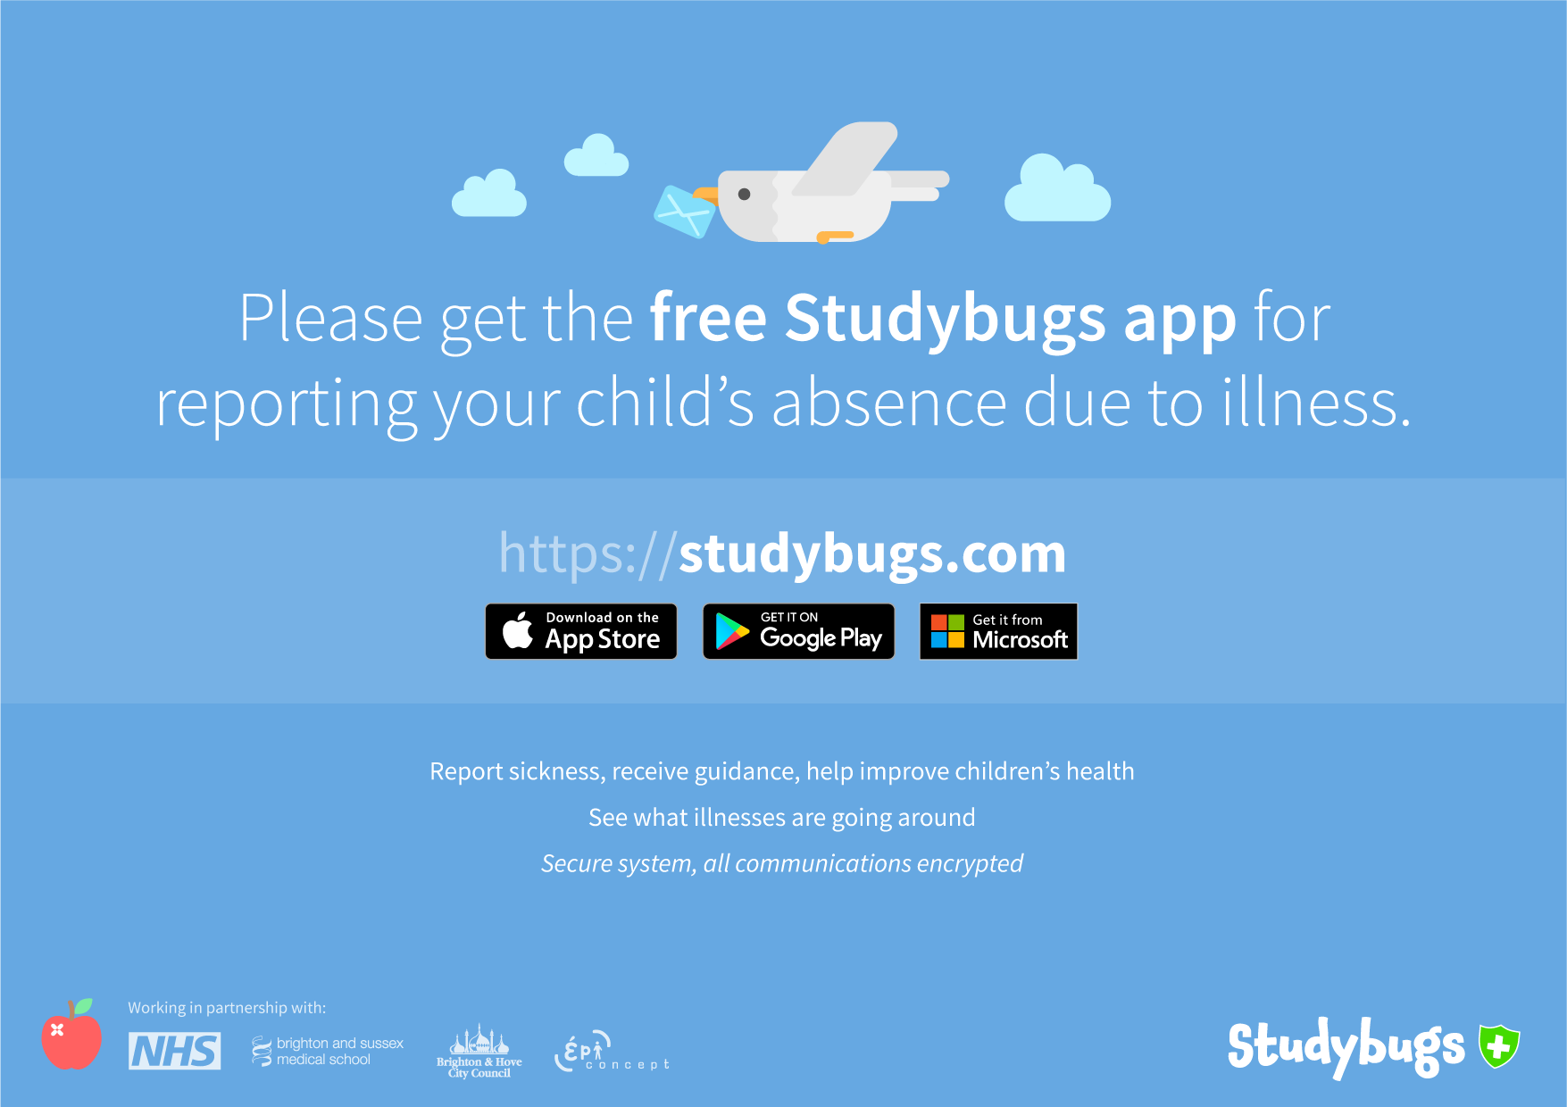

Slide 3

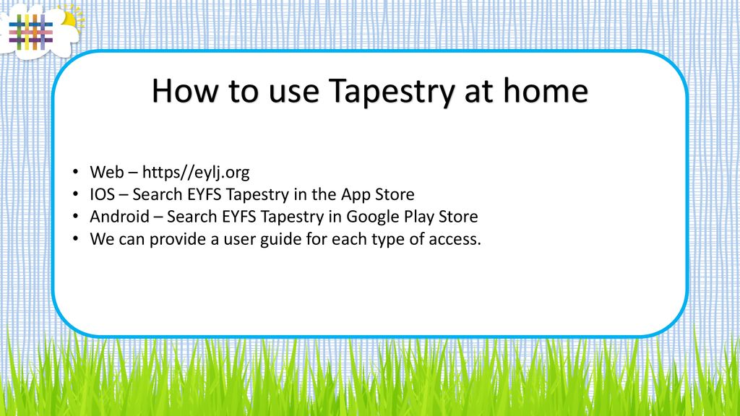
An online journal recording all the learning and fun of children's early years education.
You child will be allocated a Tapestry log in when he/she starts in Nursery or Reception. Please look out for the activation email which will be sent to your email address at some point during their first week. The email is sent directly from Tapestry and not from Thomas Willingale School and Nursery and so may go into your junk file.
If you do have any problems with Tapestry, please contact Mrs Jones in the school office on 020 8508 7287.

Slide 4
