Slide 1
Year 4 Multiplication Tables check
Parent Workshop

Slide 2
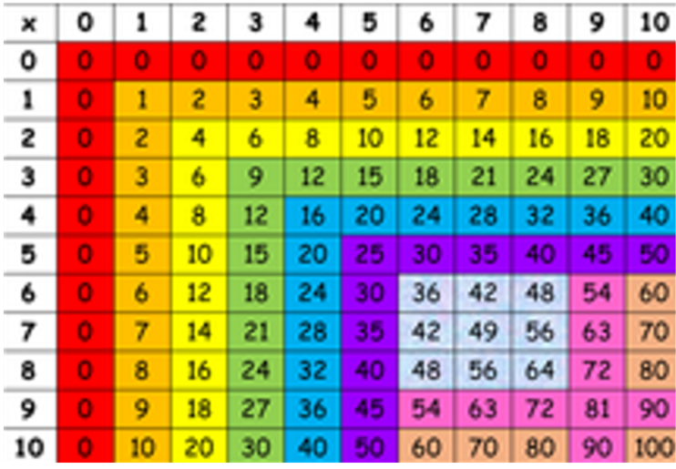
Curriculum Expectations
Under the National Curriculum, it is expected that children know all of their times tables up to 12 x 12 by the end of Year 4.

Slide 3
Multiplication tables check
Officially announced by the Department of Education in September 2017. The first year that the Multiplication Check was due to take place was Summer 2020 but this was delayed due to Covid related school closures.
The first official check was Summer 2022.
The check is a statutory requirement for all state maintained schools and academies.

Slide 4
When will the MTC be administered?
The check window opens on Monday 3rd June for a 2-week period.
All pupils must complete the check in this 2 week period.

Slide 5
How Will Scores be Used?
School-level and individual pupil results will be made available to schools. This will be used to allow schools to provide additional support to pupils who require it.
School-level results will be made available to selected users, e.g. Ofsted and the DfE in order to track standards over time.

Slide 6
How are the children tested?
Children will be tested using an on-screen check, where they will have to answer multiplication questions against the clock.
Materials that could provide children with answers will be removed from rooms where the check is to be administered.
The test will last no longer than 5 minutes, and is similar in format to the soundcheck assessments on TT Rockstars.
It will be automatically scored, and results will be available in July

Slide 7
What does the assessment look like?
Children will have 6 seconds to answer each question in a series of 25 questions.
This allows pupils the time required to demonstrate their quick recall of multiplication tables, whilst limiting pupils’ ability to work out answers to the questions.
Each question will be worth one mark and will be presented in the format …… x ……. = ……..
Once an answer has been inputted there will be a 3 second pause before the next question is shown.

Slide 8
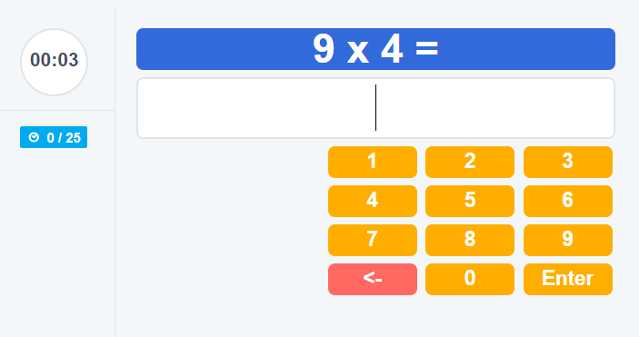
The expectation is that pupils should be able to get all 25 questions correct given the time allowed.
Children will be given the opportunity to practise answering questions in this format before the official check begins both on TT Rockstars and in practice tests available for 1 week prior to the tests themselves.

Slide 9
What is in the test?
Questions will be selected from the 121 number facts that make up the multiplication tables from 2 to 12, with a particular focus on the 6,7,8,9 and 12 times tables, as they are considered to be the most challenging.
It is expected that each question will only appear once in any 25-question series and children won’t be asked to answer reversals of questions (switchers) as part of the check.

Slide 10
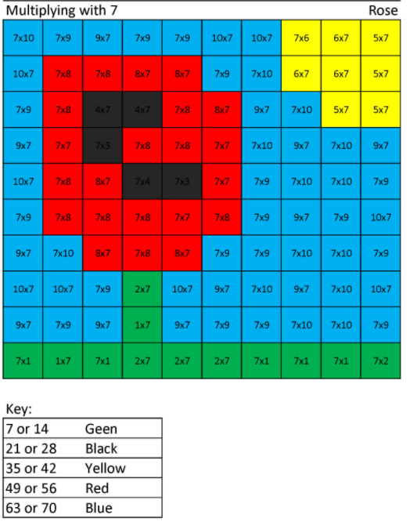
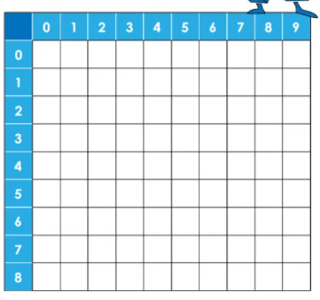

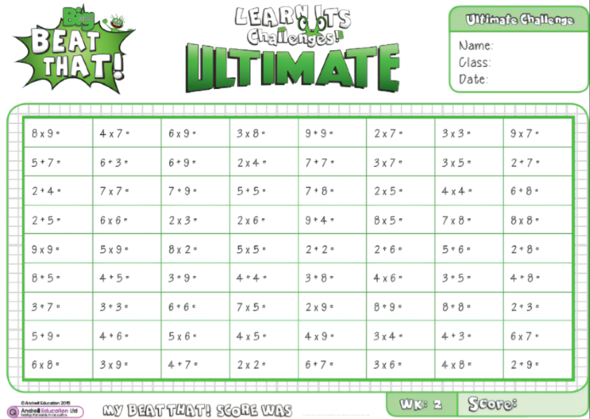


How can you help at home?
Soundcheck
www.topmarks.co.uk
Particularly Hit the Button
www.timestables.co.uk/multiplication-tables-check/

