Slide 1
Welcome to the Year 5 Parent Information Evening
Year 5 teachers
Mrs Porter & Mrs Hyett- Hawthorn class
Miss Burling- Aspen class
Upper KS2 Phase Leader:
Mrs Porter
A copy of this presentation will be available on the TWS website
(on the Year 5 page), you can therefore refer to it at your leisure.

Slide 2
School Uniform and Equipment Policy
School Uniform:
All children must wear school uniform.
If trainers are worn they must be black.
Ensure all uniform is clearly labelled.
Jewellery:
Jewellery is not to be worn.
Exceptions – a watch and small stud earrings (which must be removed before PE).
Equipment:
Stationery is provided by the school.

Slide 3
Mobile Phones – Letter sent home regarding mobile phones if your child walks home from school.
Money - As we are now a cash free school, the only money which should be brought into school by your children should be for fund raising events.
Water bottle- Make sure your child brings a water bottle to school every day.
Snacks for break time- These need to be a healthy snack.

Slide 4
TIMETABLE
Your child’s weekly timetable is available on the Thomas Willingale website.
However, just to make you aware, PE is on the following days:
Wednesday and Friday
Your child should arrive dressed in their full PE kit on those days (trainers for outside activities).

Slide 5
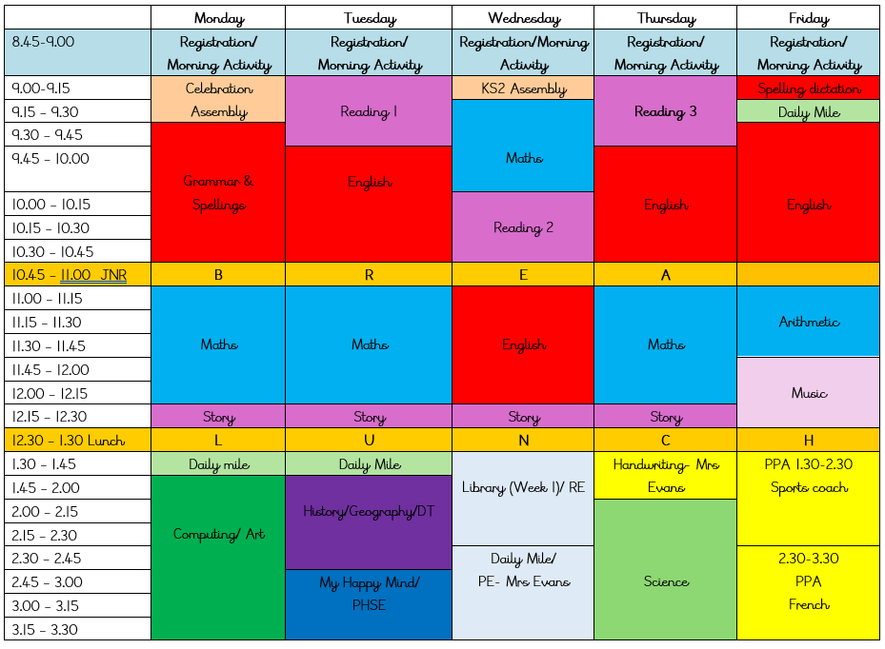
TIMETABLE

Slide 6
THE YEAR 5 CURRICULUM
MATHEMATICS – some of the main targets
YEAR 5
To recall multiplication and division facts to 12 x 12 (Year 4)
To compare and order numbers to at least a 1,000,000.
To recognise the place value of each digit in a 5 digit number.
I can add and subtract numbers mentally with increasingly large numbers.
To convert between different units of measure.
I can find fractions, decimals and percentages of amounts.

Slide 7
WRITING – some of the main targets
Year 5
To spell the commonly mis-spelt words from the year 3/ 4 and 5/6 list.
I can produce legible , joined handwriting.
I can use the correct features and sentence structure matched to the text type we are working on.
I can organise my writing into paragraphs to show different information or events.
I can evaluate and edit by ensuring mostly consistent and correct use of tense throughout a piece of writing.
I can use capital letters, full stops, question marks, commas for lists and apostrophes for contraction mostly correcting.

Slide 8
READING – some of the main targets
Year 5
I can read age appropriate books with confidence and fluency (including whole novels)
I am familiar with and can talk about a wide range of books and text types, including myths, legends and traditional stories and books from other cultures and traditions. I can discuss the features of each.
I can justify inferences with evidence from the text.
I can make predictions from what has been read.

Slide 9
TOPICS AND THEMES
Subject | Year 5
History/Geography | Achievements and Legacies Rich & Poor Balloon Blaster Earthquakes
Science | Forces Properties of Material Changes – Living things and habitats Earth and Space Reproduction – Plants and Animals.

Slide 10
Rewards
House Points
Each child allocated a house
Can earn points for their house,
E.G. - being polite, good behaviour, answering questions, manners etc.
Each week the house who has received the most points wins a trophy and at the end of each term the house who has the most points has extra play time.
Merits
Bronze merit card progress to silver, gold then platinum.
Merit cards are stamped, and children have the opportunity to visit various members of senior staff to share their success
Examples of how merits can be earned include : - producing excellent work, answering questions, doing an activity for which your child has tried their hardest, and for homework.

Slide 11
ATTENDANCE
Regular attendance is extremely important as it affects the whole class. Each week the class with the highest attendance is awarded the attendance cup. This encourages the whole class to strive for 100% attendance each week.

Slide 12
Homework
Maths and English homework will be given out on Thursdays.
Homework is due back on Tuesdays.
Homework always relates to what we are working on in class.
The children’s spellings for the week will be given on Fridays and then recorded in their reading record in school on Monday morning. Please do not use this section for any other words.
How you can further support your child: reading at home and asking comprehension questions, spellings and times tables (Timestables Rockstars)

Slide 13

Times Tables Rockstars –
An online Maths programme your child can use at home.
They can use this to practise their times tables.

Slide 14
Reading Books:
Your child will be given a reading book which they will read at school and home.
Please can we ask that you listen to your child read at least once a week and put a comment in their reading record to let us know how they have got on. However, your child should be reading daily.
When reading with your child, it is important that you ask your children questions while reading.
Reading records will be checked by the class teacher every Monday.
Each page in the reading record should be 1 week.
Reading challenges

Slide 15
Assessment
Assessments are a way of teachers finding out exactly what your child’s strengths are and also the areas which need developing. Any additional support can then be organised so that your child can progress to their maximum potential.
Your child need not worry about these assessments.

Slide 16

My Happy Mind
What is it?
My Happy Mind is an award-winning programme for schools & nurseries, families and organisations. It is delivered by class teachers across 5 modules, all designed to develop critical knowledge and habits that support children’s mental health. This means that children can develop a toolkit of resources to use when they need to.

Slide 17
Communication
Website –
We put class information on to the class pages of the TWS website.
School App –
To keep up to date with what’s going on in school, please download the school app.
Parent Consultation Meetings –
Regular formal consultation meeting will be held with yourselves in person. Y5 Parent consultations are on the Monday 21st of October 2024.
All enquiries regarding your child, you must contact the school office.

